Slide 1
Chapter 7
PROJECT SCHEDULING AND TRACKING

Slide 2
PROJECT SCHEDULING (Basic Principles)
Project Scheduling:- Project scheduling involves defining the tasks, their order, and the time required to complete them. It provides a roadmap for project execution.
Key Steps in Scheduling:
Identify Tasks (Compartmentalization.):
Break down the project into smaller, manageable tasks. In this , both the product and the process are decomposed.
Determine Task Dependencies (Interdependency.):
Understand which tasks rely on others (e.g., Task B can’t start until Task A finishes).
Estimate Time and Resources (Time allocation):
Assign time durations and resources (people, tools) to each task. Each task must be assigned a start date and a completion date.
Create the Schedule:
Use Gantt charts to visualize and plan.
Allocate Resources:
Ensure the availability of resources for the tasks to avoid bottlenecks.

Slide 3
THE RELATIONSHIP BETWEEN PEOPLE AND EFFORT
In a small software development project a single person can analyze requirements, perform design, generate code, and conduct tests. As the size of a project increases, more people must become involved.
There is a common myth that is "If we fall behind schedule, we can always add more programmers and catch up later in the project."
Unfortunately, adding people late in a project often has a disruptive effect on the project, causing schedules to slip even further.
The people who are added must learn the system, and the people who teach them are the same people who were doing the work.
While teaching, no work is done, and the project falls further behind.
Adding people late increased communication overhead, slightly reducing productivity.
However, teams are not counterproductive because good communication can improve software quality (e.g., through error detection and technical reviews).
Higher quality software reduces testing time and leads to better customer satisfaction, balancing the impact on raw productivity.

Slide 4
Example :-
Consider four software engineers, each capable of producing 5000 LOC/year when working on an individual project.
When these four engineers are placed on a team project, six potential communication paths are possible. Each communication path requires time that could otherwise be spent developing software.
We shall assume that team productivity (when measured in LOC) will be reduced by 250 LOC/year for each communication path, due to the overhead associated with communication. Therefore, team productivity is 20,000 - (250 x 6) = 18,500 LOC/year—7.5 percent less than what we might expect.

Slide 5


An Empirical Relationship
The number of delivered lines of code (source statements), L, is related to effort and development time by the equation:
$$L^{ }{=P}^{ }\text{x} E^{1/3}{ T}^{4/3}$$
L: Delivered lines of code (source statements).
P: Productivity parameter that reflects a variety of factors that lead to high-quality software engineering work (between 2000 and 12,000).
E: Development effort in person-months (or person-years).
t: Project duration in calendar months (or years).
Rearranging this software equation, we can arrive at an expression for development effort E:
$$E^{ }{{=L}^{3}/(P^{3}T}^{4})$$
where E is the effort expended (in person-years) over the entire life cycle for software development and maintenance and t is the development time in years.

Slide 6
DEFINING A TASK SET FOR THE SOFTWARE PROJECT
A number of different process models we have. These models offer different paradigms for software development. , the process model is populated by a set of tasks that enable a software team to define, develop, and ultimately support computer software.
No single set of tasks is appropriate for all projects. Therefore, an effective software process should define a collection of task sets, each designed to meet the needs of different types of projects.
A task set is a collection of software engineering work tasks, milestones, and deliverables that must be accomplished to complete a particular project. The task set to be chosen must provide enough discipline to achieve high software quality. But, at the same time, it must not burden the project team with unnecessary work.
Task sets are designed to accommodate different types of projects and different degrees of rigor.
Most software organizations encounter the following projects:
Concept development projects :- To explore and evaluate new business ideas or emerging technologies.
New application development projects :- To develop a completely new software solution based on specific customer requirements.
Application enhancement projects :- To significantly upgrade or modify existing software to improve functionality, performance, or usability.
Application maintenance projects :- To correct errors, adapt the software to new environments, or make minor improvements that are not obvious to end-users.
Reengineering projects

Slide 7
Degree of Rigor
The degree of rigor is about how carefully and formally we follow rules and steps when creating software. It depends on how important, complex, or risky the project is.
Critical systems (e.g., healthcare, aerospace) require higher rigor.
Informal or exploratory projects (e.g., prototypes) may require less rigor.
Four different degrees of rigor can be defined:
1.Casual Rigor:
Applied to small, simple, or low-risk projects.
Minimal documentation and lightweight processes.
Suitable for proof-of-concept or early prototypes.
2.Structured Rigor:
Applied to medium-sized projects with moderate risks.
Involves systematic processes, adequate documentation, and reviews.
Balances flexibility and discipline.
3.Strict Rigor:
Applied to large, complex, or critical projects (e.g., safety-critical software).
Includes comprehensive documentation, formal verification, and strict adherence to standards.

Slide 8
4.Quick reaction :-
The team focuses only on the most important tasks needed to ensure the software works well and meets basic quality standards.
Tasks like full documentation, detailed reviews, or additional testing are postponed until after delivery.
It's like doing the bare essentials first to deliver quickly and then completing the rest (called back-filling) later.
Defining Adaptation Criteria
Adaptation criteria are used to determine the recommended degree of rigor with which the software process should be applied on a project. Eleven adaptation criteria are defined for software projects:
• Size of the project
• Number of potential users
• Mission criticality
• Application longevity
• Stability of requirements
• Ease of customer/developer communication
• Maturity of applicable technology
• Performance constraints
• Embedded and nonembedded characteristics
• Project staff
• Reengineering factors

Slide 9
Each of the adaptation criteria is assigned a grade that ranges between 1 and 5,
1 represents a project in which a small subset of process tasks are required and overall methodological and documentation requirements are minimal,
5 represents a project in which a complete set of process tasks should be applied and overall methodological and documentation requirements are substantial.

Slide 10
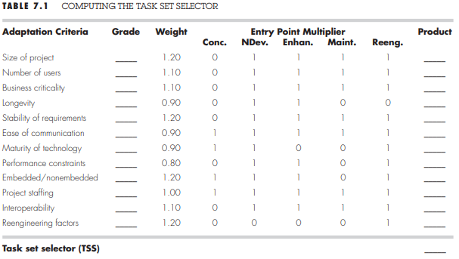
Computing a Task Set Selector Value(TSS)
To select the appropriate task set for a project, the following steps should be conducted:
Review each of the adaptation criteria and assign the appropriate grades (1 to 5) based on the characteristics of the project. These grades should be entered into above Table.
Review the weighting factors assigned to each of the criteria. The value of a weighting factor ranges from 0.8 to 1.2 and provides an indication of the relative importance of a particular adaptation criterion to the types of software developed.

Slide 11
3. Multiply the grade entered in Table by the weighting factor and by the entry point multiplier for the type of project to be undertaken.
The entry point multiplier takes on a value of 0 or 1 and indicates the relevance of the adaptation criterion to the project type. The result of the product :-
grade * weighting factor * entry point multiplier
4. Compute the average of all entries in the Product column and place the result in the space marked task set selector (TSS). This value will be used to help select the task set that is most appropriate for the project.
Once the task set selector is computed, the following guidelines can be used to select the appropriate task set for a project:
Task set selector value Degree of rigor
TSS < 1.2 casual
1.0 < TSS < 3.0 structured
TSS > 2.4 strict

Slide 12
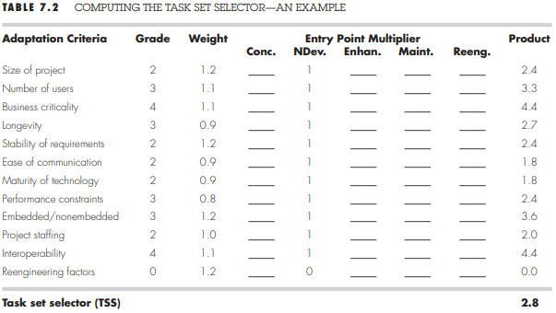
In above table illustrates how TSS might be computed for a hypothetical project :-
The project manager selects the grades shown in the Grade column.
The project type is new application development. Therefore, entry point multipliers are selected from the NDev column.
The entry in the Product column is computed using
Grade * Weight * NewDev entry point multiplier
The value of TSS (computed as the average of all entries in the product column) is 2.8. Using the criteria discussed previously, the manager has the option of using either the structured or the strict task set. The final decision is made once all project factors have been considered.

Slide 13
SELECTING SOFTWARE ENGINEERING TASKS
the task set will vary depending upon the project type and the degree of rigor.
The major software engineering tasks described in the sections that follow are applicable to all process model flows.
As an example, we consider the software engineering tasks for a concept development project:-
Concept development projects are approached by applying the following major tasks:
Concept scoping determines the overall scope of the project.
Preliminary concept planning :- the team (or manager) must determine whether anyone is available to do it.
Technology risk assessment evaluates the risk associated with the technology to be implemented as part of project scope.
Proof of concept demonstrates the viability of a new technology in the software context.
Concept implementation:- implement it in a prototypical manner so that the customer can evaluate it.
Customer reaction to the concept solicits feedback on a new technology concept and targets specific customer applications.

Slide 14
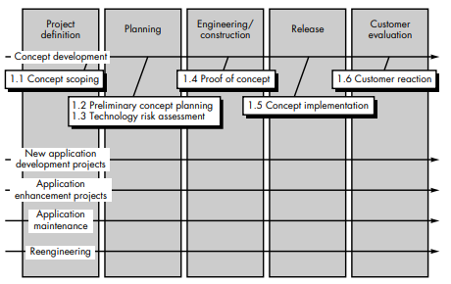

Slide 15
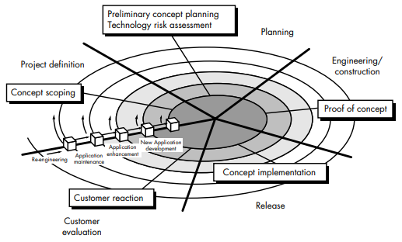
REFINEMENT OF MAJOR TASKS
The diagram illustrates the refinement of major tasks in a software development project by showing how tasks are organized and evolve through different stages of the project lifecycle.

Slide 16
1.Planning:
Tasks like preliminary concept planning and technology risk assessment are performed.
These tasks focus on defining the scope and evaluating risks before starting actual development.
2.Engineering/Construction:
Includes tasks such as creating a proof of concept to validate feasibility and design.
This phase involves building prototypes or initial solutions to ensure the chosen approach works.
3.Release:
Concept implementation occurs, where the software is developed, tested, and made ready for deployment.
At this stage, the product is nearly complete and ready for customer evaluation.
4.Customer Evaluation:
After the release, customers provide feedback on the delivered product or concept.
The feedback helps refine and improve the software in future iterations.

Slide 17
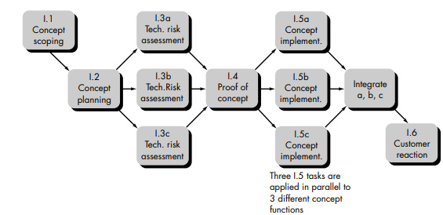
DEFINING A TASK NETWORK
Individual tasks and subtasks have interdependencies based on their sequence. In addition, when more than one person is involved in a software engineering project, it is likely that development activities and tasks will be performed in parallel. When this occurs, concurrent tasks must be coordinated so that they will be complete when later tasks require their work product(s).
A task network, also called an activity network, is a graphic representation of the task flow for a project.

Slide 18
SCHEDULING
Scheduling of a software project does not differ greatly from scheduling of any multitask engineering effort.
Program evaluation and review technique (PERT) and critical path method (CPM) are two project scheduling methods that can be applied to software development.
Both techniques are driven by information already developed in earlier project planning activities:
• Estimates of effort
• A decomposition of the product function
• The selection of the appropriate process model and task set
• Decomposition of tasks
Both PERT and CPM provide quantitative tools that allow the software planner to
determine the critical path—the chain of tasks that determines the duration of the project;
establish “most likely” time estimates for individual tasks by applying statistical models;
calculate “boundary times” that define a time "window" for a particular task

Slide 19
Tracking the schedule
Tracking the schedule of a software project involves monitoring progress to ensure the project stays on track, achieves milestones, and addresses problems as they arise.
Tracking can be accomplished in a number of different ways:
1.Regular Status Meetings:Team members report what has been done, challenges they’re facing, and what’s next.
2.Review Results:Regularly check the outcomes of reviews (like code reviews or design reviews) to track progress.
3.Check Milestones:Verify whether the project milestones (important checkpoints) are completed on time.
4.Compare Planned vs. Actual Dates:Look at the schedule and see if tasks started and ended as planned.
5.Informal Discussions:Talk casually with team members to understand progress and upcoming risks.
6.Earned Value Analysis (EVA):Use quantitative metrics to measure how much work has been completed compared to the planned budget and schedule.

Slide 20
Time-Boxing Strategy
When the deadline is tight, time-boxing helps manage the schedule:
The project is divided into smaller parts, called increments, which are delivered step by step.
A fixed amount of time (a "box") is allocated for each task.
For example, Task A has 3 days; Task B has 5 days.
When the allocated time for a task ends (even if the task isn’t 100% done), work moves to the next task.
This ensures the project progresses steadily.

Slide 21
Earned Value Analysis (EVA)
Earned Value Analysis (EVA) is a quantitative method used by project managers to measure how much work has been completed in a project compared to the plan. Instead of relying on guesses or opinions, it provides clear numbers to assess progress and performance . calculation of EVA
Budgeted Cost of Work Scheduled (BCWS):
This is the planned effort for each task in the schedule. It’s how much work was supposed to be completed by now.
Example: If two tasks were planned to take 5 and 3 days, the total BCWS is 8 days.
Budgeted Cost of Work Performed (BCWP):
This is the actual value of the work that has been completed so far.
Example: If a task that was planned to take 5 days is only half done, its BCWP is 2.5 days.
Budget at Completion (BAC):
This is the total planned effort for the entire project.
It’s calculated by summing up the BCWS for all tasks.
Example: If the project has 10 tasks with 5 days each planned, the BAC is 50 days.

Slide 22
ERROR TRACKING
Error tracking involves monitoring and analyzing the errors that occur during the development of work products (like requirements, design documents, or code). This helps project managers assess the quality and progress of a project.
Errors vs. Defects:
Errors (E): Mistakes found during reviews or testing of work products (e.g., in requirements, design, or code).
Defects (D): Errors that are not caught during reviews/testing and are discovered later in the process or by the end user.
Defect Removal Efficiency (DRE):
DRE is a metric that evaluates how effective the team is at detecting and removing errors early in the process.
Formula:
DRE=E/E+D​
E: Errors found during reviews/testing.
D: Defects found later.
A high DRE value means the team is catching most errors early.

Slide 23
To track errors and defects effectively, software organizations use the following metrics based on historical data:
Errors per requirements specification page (Ereq): Tracks the average number of errors per page in the requirements document.
Errors per component—design level (Edesign): Measures errors found in design documents per component.
Errors per component—code level (Ecode): Counts errors found in code for each component.
DRE for requirements analysis: Measures the effectiveness of finding errors in the requirements phase.
DRE for architectural design: Assesses the removal of design-level errors.
DRE for component-level design: Focuses on detecting errors during detailed design.
DRE for coding: Checks the effectiveness of catching coding errors during reviews/testing.
Using historical error data from past projects, managers can compare real-time error rates to identify whether the current project is on track.
If error counts or DRE values deviate significantly from the baseline, it signals potential quality issues that need attention.

Slide 24
THE PROJECT PLAN
The Software Project Plan is a key document that summarizes how a software project will be executed. It is created after completing the planning tasks and serves as a foundation for all subsequent work in the project.
The component of the Project Plan is:-
Scope and Resources:
Defines what the project will deliver (scope) and the resources (time, people, tools) required to complete it.
Risk Management:
Lists possible risks (e.g., delays, budget issues, technical challenges) and the strategies to handle them.
Cost and Schedule:
Provides a breakdown of estimated costs and a timeline for completing tasks and milestones.
Development Approach:
Describes how the software will be developed, including the chosen methodologies, tools, and standards.
Quality Assurance and Change Management:
Explains how quality will be monitored and how changes (in requirements, scope, etc.) will be managed.

